Slide 1
RECIPEHUB
FOOD RECIPE MANAGEMENT SYSTEM
A simple desktop application to create, explore and manage recipes
BREAKFAST
LUNCH
DINNER
SNACKS
PROJECT PRESENTATION
Built with Core Java • Java Swing • File Handling
GitHub Project Documentation

Slide 2
01 Project Overview
What is RecipeHub?
The idea
The purpose
RecipeHub is a Java Swing desktop application for managing food recipes in one place. Users can add recipes, browse the list, search, save favourites and rate recipes.
The project demonstrates how a simple graphical application can organize recipe information and store it locally so that saved data is available after restarting.
Project type: Local desktop prototype
The current version uses usernames to simulate different users on the same computer. It does not yet provide real online sharing.
02

Slide 3
02 Problem Statement & Objectives
Why this application is useful
Problem statement
Project objectives
Recipes may be stored in notebooks, messages or separate files. Finding a recipe, keeping favourites and comparing ratings can become difficult.
RecipeHub brings these activities together in one simple application.
• Make recipe management easy
• Organize recipes by category
• Search by recipe name or ingredients
• Save favourite recipes
• Collect ratings and show average scores
• Store information locally
03

Slide 4
03 Main Features
Key functions available in the current version
Recipe management
Search & filter
Favourites
Add, view, edit and delete recipes.
Search by name or ingredient; filter by category.
Save recipes to a personal collection or remove them.
Ratings
Average rating
Top 5 recipes
Rate a recipe from 1 to 5; update your rating later.
Calculate and display the average score.
Show the five recipes with the highest average ratings.
04

Slide 5
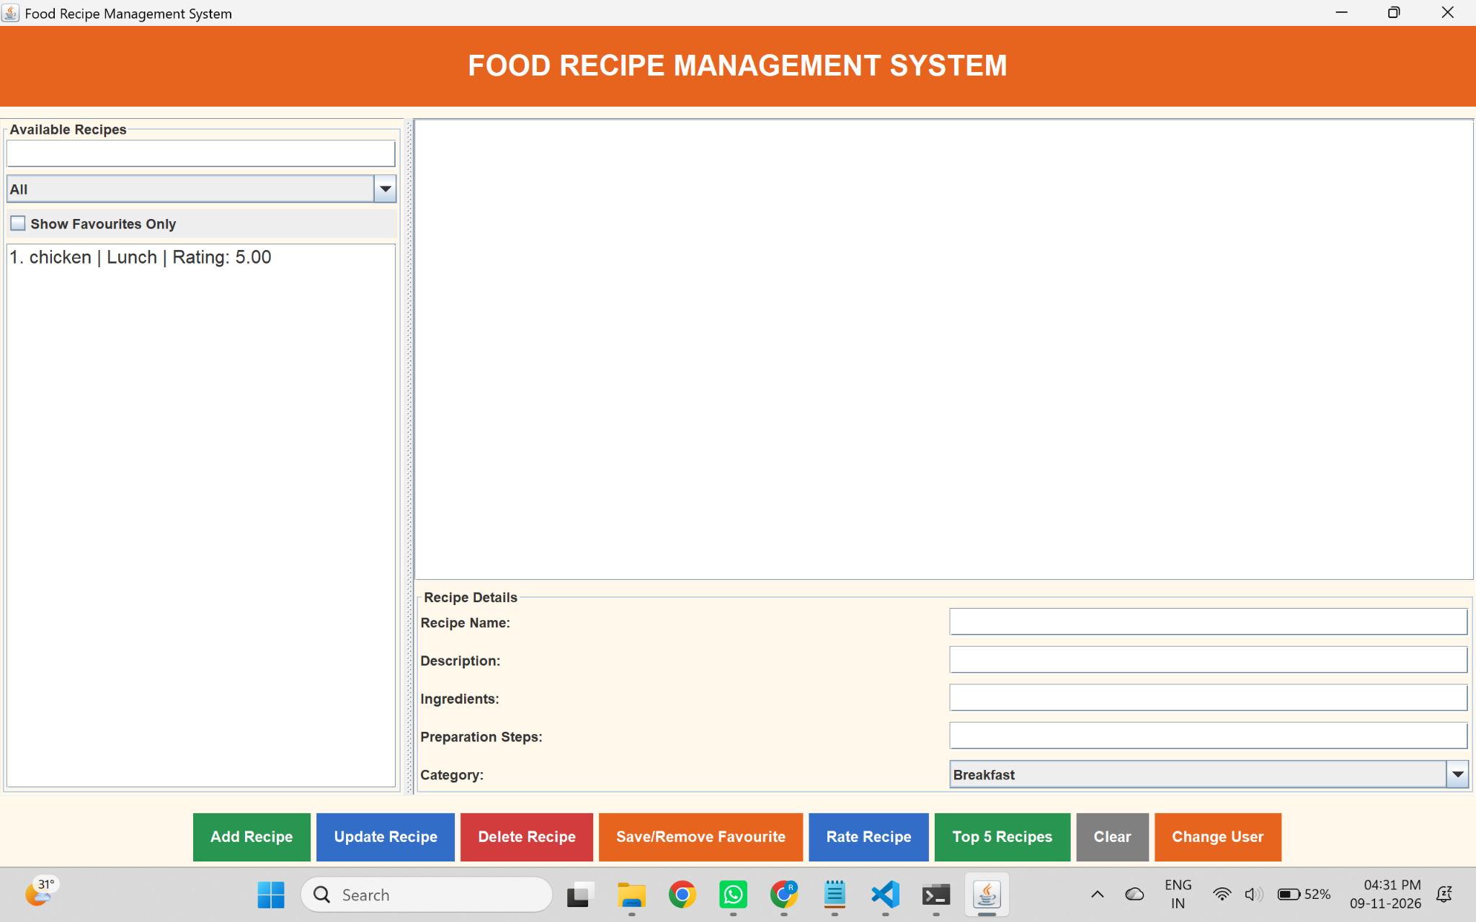
04 Application Interface
Screenshot of the running RecipeHub application
Orange heading • Recipe list • Details form • Colour-coded action buttons
05

Slide 6
05 How the Application Works
Typical user workflow
1
→
2
→
3
→
4
→
5
Open app
Choose action
Manage recipe
Interact
Save data
Launch the Java desktop application.
Add a recipe or select an existing recipe.
View details, edit, delete, search or filter.
Save a favourite or submit a rating.
Changes are stored in the local data file.
Data persistence
Recipe details, favourites and ratings are saved to recipes.dat using Java object serialization.
06

Slide 7
06 Technologies & Project Structure
How the code is organized
Technologies
Source code structure
• Core Java – application logic
• Java Swing – graphical user interface
• Java Collections – lists and maps
• File handling & serialization – local storage
• JDK – compile and run the project
src/model/Recipe.java
Stores recipe details and rating logic.
src/service/RecipeService.java
Handles recipe operations and file storage.
src/main/Main.java
Builds the Swing interface and connects user actions to the service.
07

Slide 8
07 How to Compile & Run
Run locally from the RecipeHub project folder
1. Check Java installation
java -version | javac -version
2. Compile the source files
javac -d out src\model\Recipe.java src\service\RecipeService.java src\main\Main.java
3. Start the application
java -cp out main.Main
The recipes.dat file is created automatically in the folder from which the application is run.
08

Slide 9
08 Limitations & Future Enhancements
Possible improvements for later versions
Current version
Future enhancements
• Runs as a desktop application
• Stores data locally on one computer
• Usernames are a simple simulation, not secure login
• No remote database or live online sharing
• User registration and secure login
• Online database integration
• Share recipes between different devices
• Upload recipe images
• User profiles and improved interface
• Web or mobile version
09

Slide 10
THANK YOU!
RecipeHub – Food Recipe Management System
A simple project demonstrating Java programming, GUI development and local data storage.
GitHub Project Presentation

